Slide 1

The "Resource-Process-Product" Mineralization triptych
–
Application to New-Caledonian Nickel slags
Florent Bourgeois, Prof.
Laboratoire de Génie Chimique, Université de Toulouse, CNRS
Toulouse, France
@LGClab

Slide 2
The "Resource-Process-Product" Mineralization triptych
–
Application to New-Caledonian Nickel slags
PRESENTATION OUTLINE
Making sense of mineral carbonation: the mineralization triptych
Context : Development of CO₂ mineralization in New-Caledonia
Resource : Pyrometallurgical Ni-slags
Process : Mineralization technology development
Product : Mg-based construction materials
Environmental and Economic Analysis
@LGClab
2

Slide 3

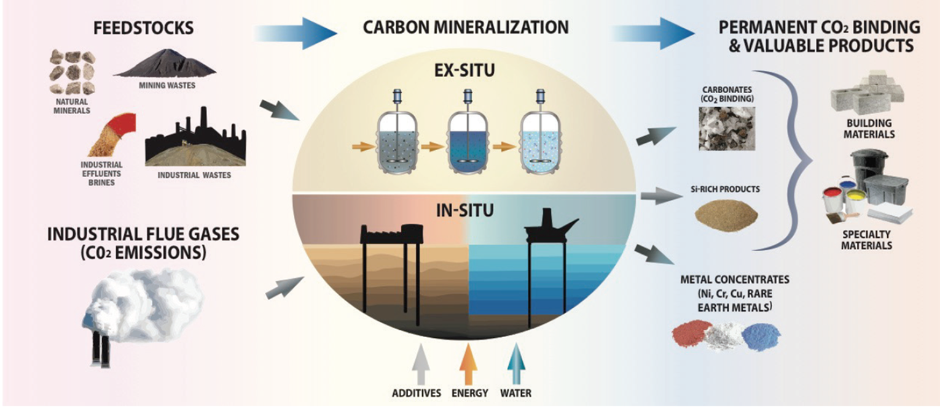

Making sense of Mineral Carbonation : The mineralization triptych
"Historically", CO₂ mineralization was compared to geological storage (CCS), in terms of the cost of CO₂ storage and avoided CO₂."
CCUS must be built upon a viable economic model
Source: Mission Innovation, Accelerating Breakthrough Innovation in Carbon Capture, Utilization, and Storage, 2018
Today, mineralization of CO₂ is seen as a means to produce valuable products, simultaneously combining storage and valorization of CO₂, bringing environment and economy together.
@LGClab
3
Notes:
Economic drawbacks have been the major barrier for the deployment of CCUS technologies at large scale.

Slide 4
Making sense of Mineral Carbonation : The mineralization triptych
Three CO₂ mitigation criteria according
to the International Energy Agency :
Substantial reduction of CO₂ emissions
Economic self-sufficiency
Scalability
Source: International Energy Agency, 20 Years of Carbon Capture and Storage - Accelerating Future Deployment, OECD/IEA; 2016.
No universal standalone solution
  > mineralization is a fully integrated issue !
Industrial residues = feedstock opportunity (reactivity; liability; cost of remediation)
Resource = Feedstock + CO₂ source
Products, markets & feedstocks lead to the regional concept of integrated mineralization.
Economic self-sufficiency requires "a viable economic model":
A net positive economic value over a set time return (a market; unsubsidised earnings ; a secured & proven feedstock).
A net positive value to society (waste reduction; valuable products; climate mitigation) .
A net positive environmental impact (climate mitigation; no wasteful consumption of natural resources (water, minerals)).
Scalability requires the mineralization scheme to be tailorable to the intended market.
The regionalized triptych
"resource-process-product"
is a pillar of integrated CO₂ mineralization
There is a great deal more to CO₂ mineralization than developing an efficient mineralization reactor !
@LGClab
4
Notes:
Insist upon the fact that integrated mineralization can be locally small in scale (in comparison with the magnitude of the CO2 mitigation issue), BUT the concept can be revisited and implemented all over the world; hence it can be considered as a global niche solution.
Resource = feedstock and CO2 source !
seeking a standalone mineralization process that fits all is illusory

Slide 5
Making sense of Mineral Carbonation : The mineralization triptych
Concrete is the second most commonly used mineral resource after water, with approximately 4 billion tonnes produced in 2013 (Nature Geoscience, 2016, Xi et al.)
Approximately 5% of global CO₂ emissions emitted by man come from the sole manufacture of cement
1.9 t of raw materials
1500 kg of Ca- carbonates (80%)
400 kg clays (20%)
535 kg CO₂
(65%)
T° calcination
∼900-1000°C
1 t of clinker
285 kg CO₂
(35%)
Fossil fuel
(3200 MJ)
∼1t of ciment (OPC)
= hydraulic binder
gypsum
Mineralization, as a CO₂ mitigation solution, seeks alternate materials and production routes with reduced environmental footprint
@LGClab
5

Slide 6
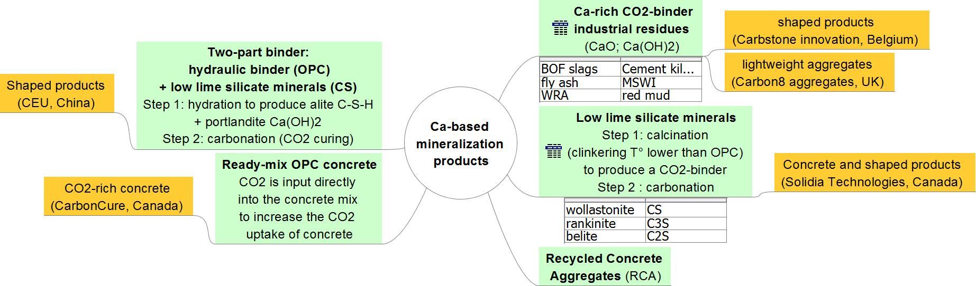
Making sense of Mineral Carbonation : The mineralization triptych
Mineralization: A creative and engaging field
Ca-based mineralization products = early opportunities of CO₂ mineralization
Economic evaluation and life cycle analysis
necessary to check the net local benefit of the proposed schemes
A few significant points: CO₂ source & purity ; product environmental impact (leaching)
@LGClab
6
Notes:
BF = Blast Furnace slags : 15-60% CaO;
Fly ash: 10-50% CaO
RCA: Waste (or Recycled) concrete aggregate =25-66% CaO
Red mud = 8% CaO; 30% Fe2O3; 25% Al2O3; 11% SiO2
Ca(OH)2 = portlandite
Steel slags = Stainless Steel slags; BOF slags; EAF slags;
CARBONCURE/Canada: Direct injection of CO₂ into concrete as it is being mixed (less cement usage per ton of concrete: ↘cost; ↘ CO₂ emissions) = Accelerated carbonation of concrete
CEU = State Key Laboratory on Clean Energy Utilization
wollastonite CS = CaSiO₃, rankinite C₃S = Ca₃Si₂O₇, belite C₂S = Ca₂SiO₄
Water to solid ratio of 0.1 is conducive to (favours) carbonation reactions

Slide 7
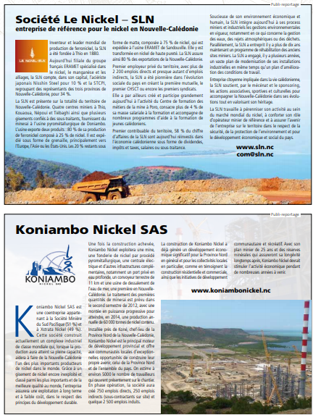
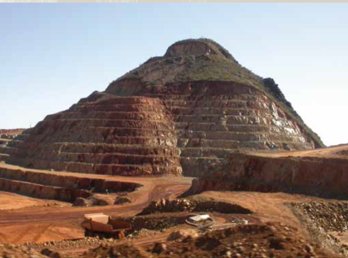
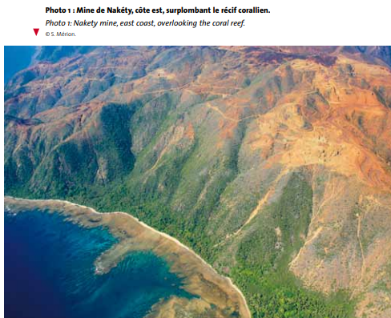
Context : Development of CO₂ mineralization in New-Caledonia
10% of the world's Ni reserves; 9% (2016) of world production
Annual production of Ni ≈ 100,000 tons (5th world producer)
4% of the active population
20% of New Caledonia's GDP
-
Stainless steels (stainless steel) 67% - Other ferrous alloys with nickel 7% - Non-ferrous alloys, superalloys 11% - Electroplating / nickel plating (surface coatings) 8% - Other uses (NiMH batteries, catalysis, chemistry, etc.) 7 %
Critical: High Strategic Industrial Importance / Low Supply Risk (Low Price: US $ 12,000 / t)
Source: Bernard Robineau, Laurence Berthault, Patrice Christmann. Nouvelle-Calédonie, terre de Nickel. Geosciences, 2011, p.50-57.
7

Slide 8
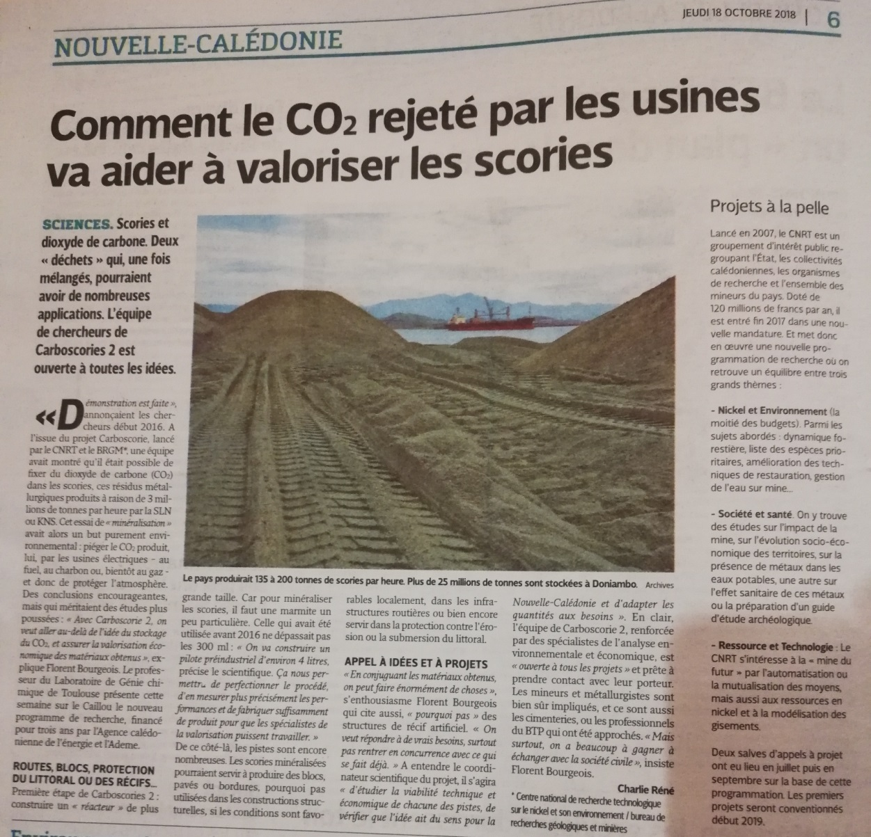
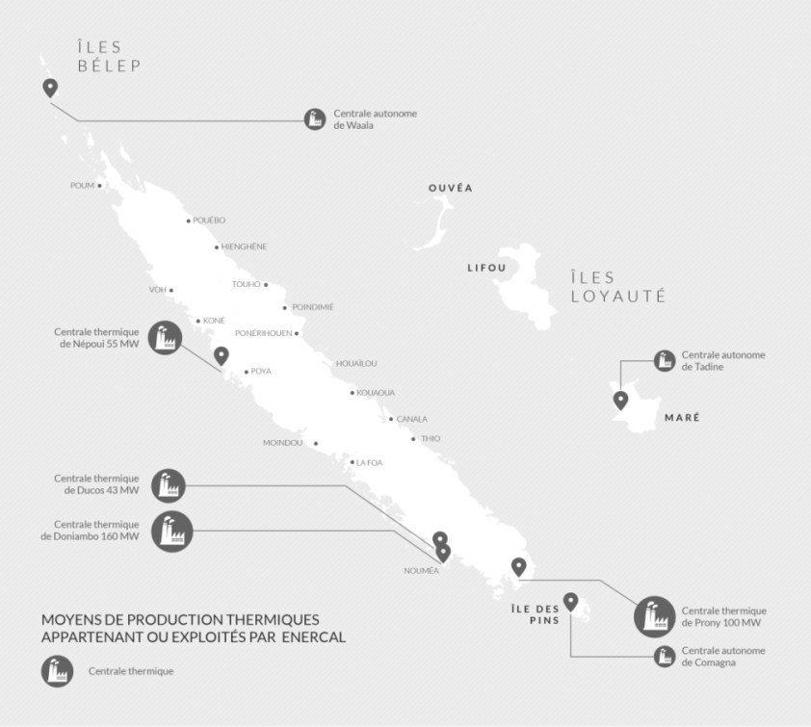
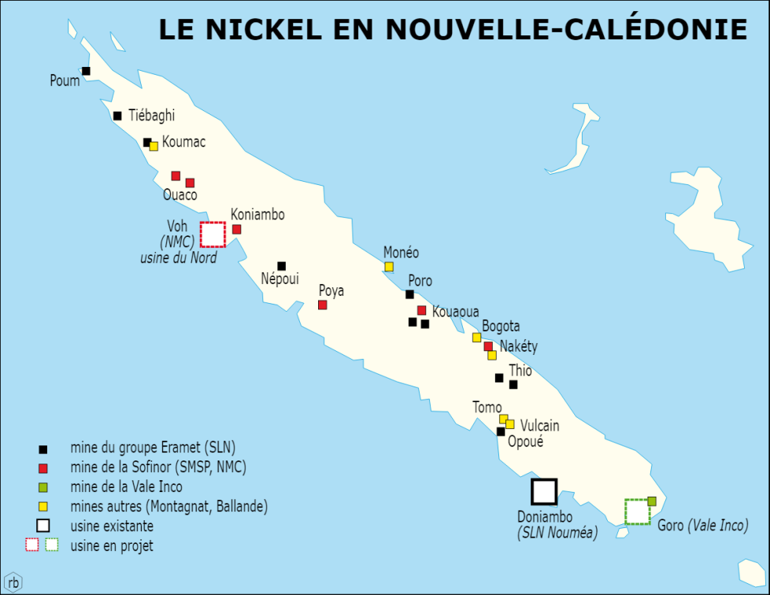
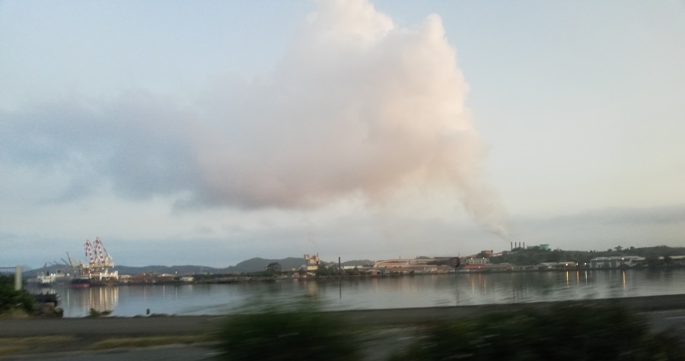
Context : Development of CO₂ mineralization in New-Caledonia
80% of the energy consumed in New Caledonia is thermal (pulverized coal, fuel oil, diesel, soon natural gas).
3.6 Mt CO₂ / y, of which 1.9 Mt (52%) is from metallurgy and mining.
14.9 t CO₂ / inhabitant (280 000 inhabitants, 1 900 000 ha)
3 million tonnes of slag per year (≈ 1.8 Mt SLN, 1.2 Mt KNS)
Max. Potential CO₂ sequestration: 0.4 t CO₂ / t slag
8
Notes:
Superficie = 2 x Corse
Population = 0.85 x Corse (330 000 hab.)

Slide 9
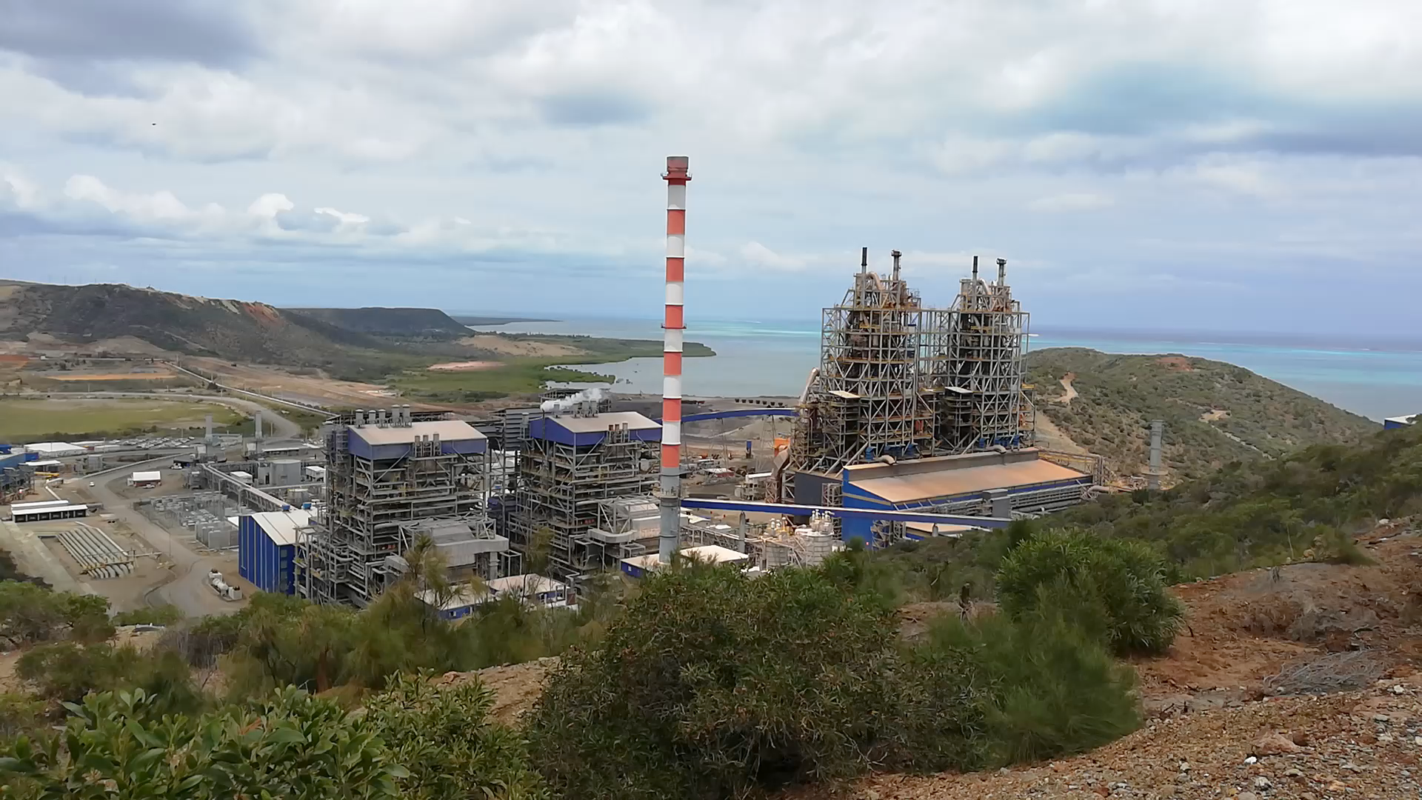
Context : Development of CO₂ mineralization in New-Caledonia
Koniambo plant - KNS - North Province
9

Slide 10
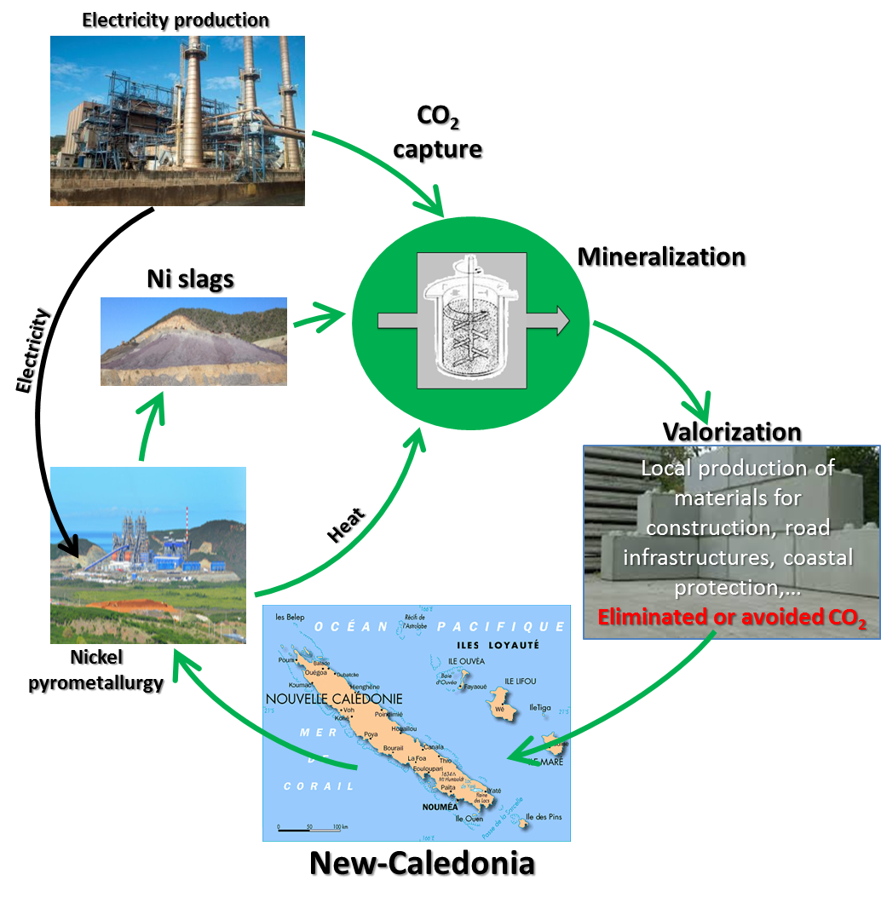
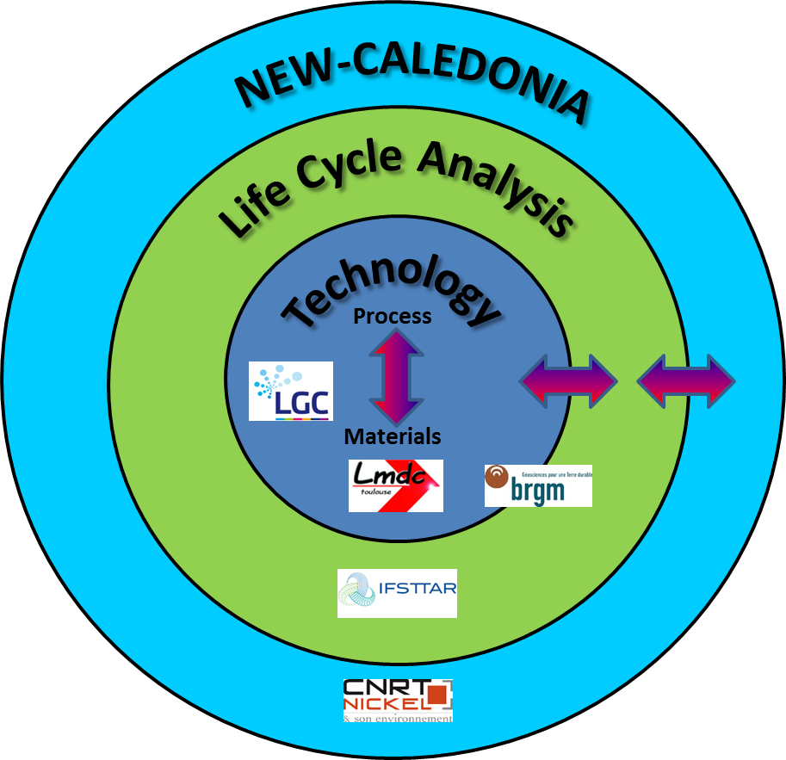
Context : Development of CO₂ mineralization in New-Caledonia
Funding bodies:
New-Caledonian Energy Agency (ACE)
French Environment & Energy Management Agency (ADEME)
Duration: 2018-2021
Funding: approx. 1M€
Stakeholders
New-Caledonia
Civil Society
Public institutions / Governing authorities
Industry: Ni mining; Construction / cement; Energy production
Project team
Funding bodies
Export
(S-E Asia, Australia, N-Z)
10
Notes:
Nouvelle-Calédonie: 15 Mt de CO2 par habitant (245000 habitants) = 3.6 Mt CO2/an
Métallurgie et mines du Ni: 50% des émissions de CO2 de la Nouvelle-Calédonie = 1.9 Mt CO2/an

Slide 11
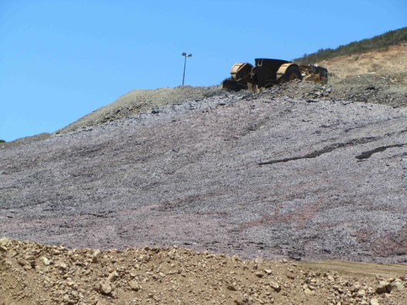
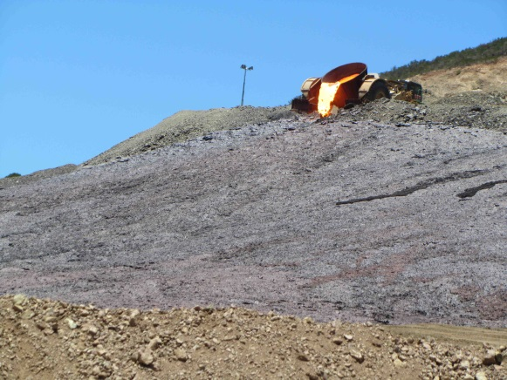
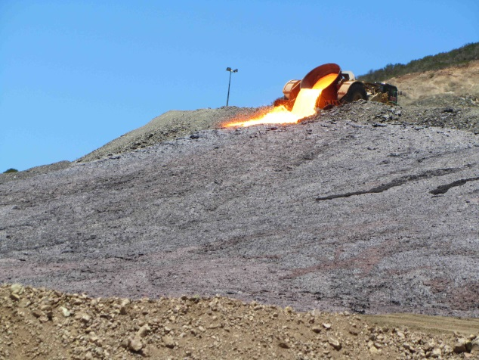
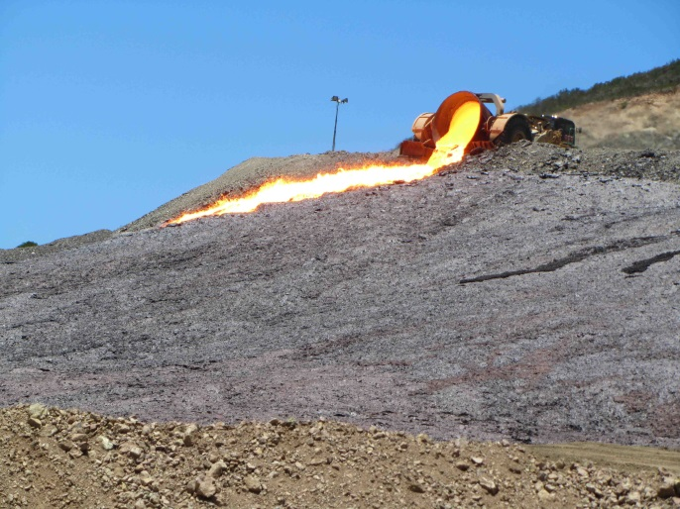
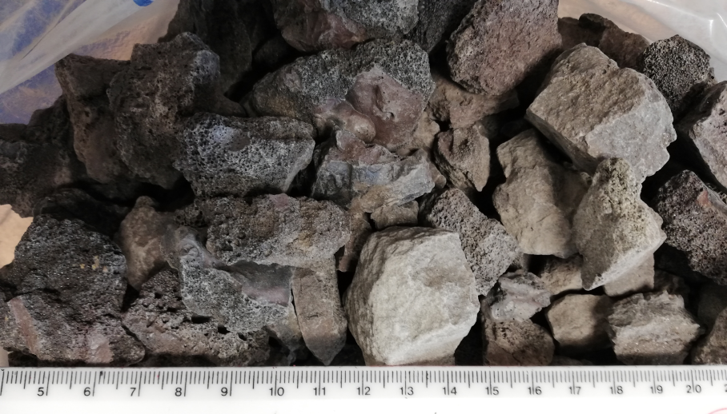
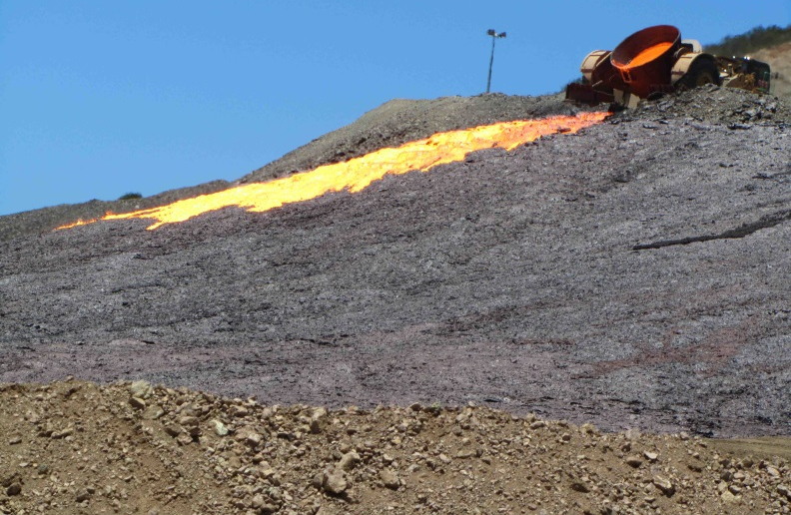
Resource : Pyrometallurgical Ni-slags
Koniambo plant - KNS - North Province
Composition in oxides (% by weight)
SiO₂ | 50-55%
MgO | 30-35%
FeO – Fe(II) | 10-15%
Al₂O₃ | 1-3%
Cr₂O₃ – Cr(III) | 2%
CaO | 0.2-0.6%
11

Slide 12
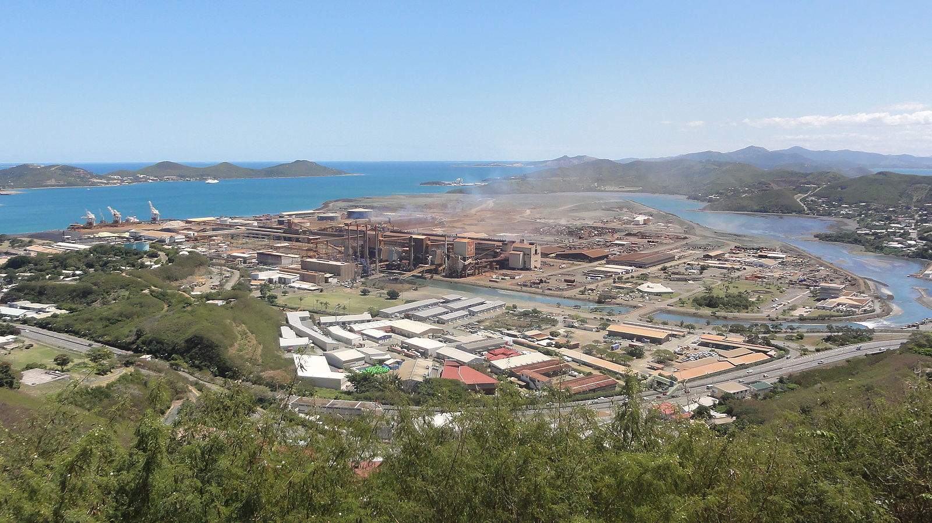
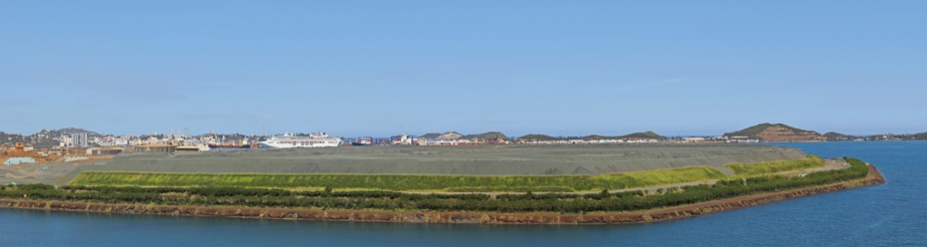
Resource : Pyrometallurgical Ni-slags
Doniambo plant - SLN - South Province (Noumea)
Slag storage of the Doniambo's big verse will reach 63 meters in 2050
12

Slide 13
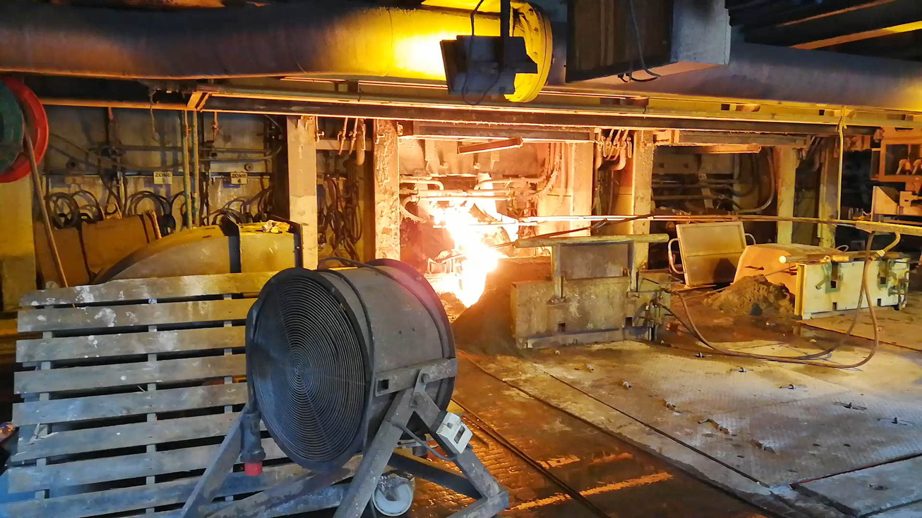
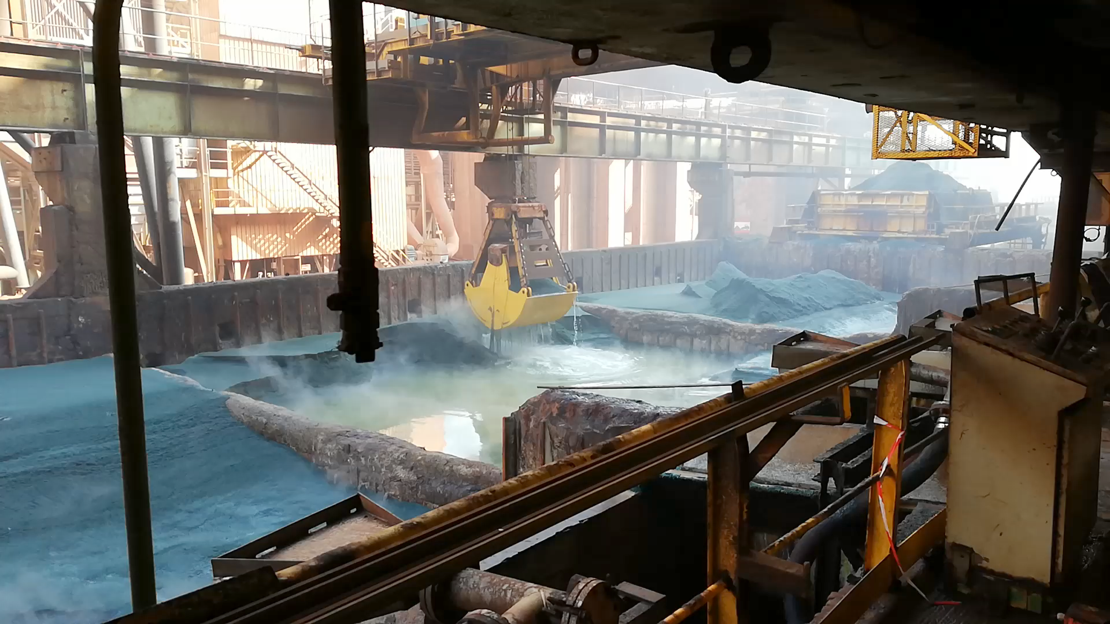
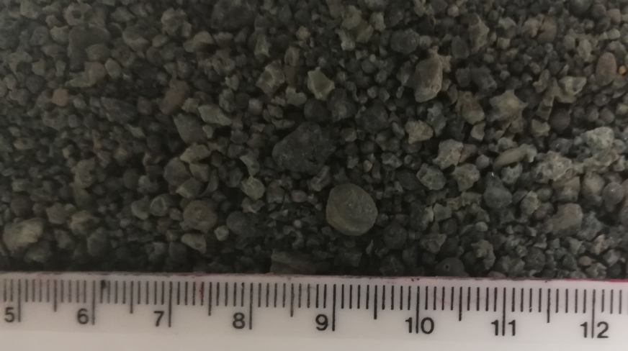
Resource : Pyrometallurgical Ni-slags
Doniambo plant - SLN - South Province (Noumea)
13

Slide 14
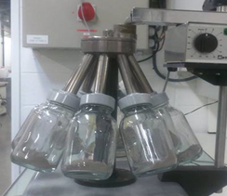
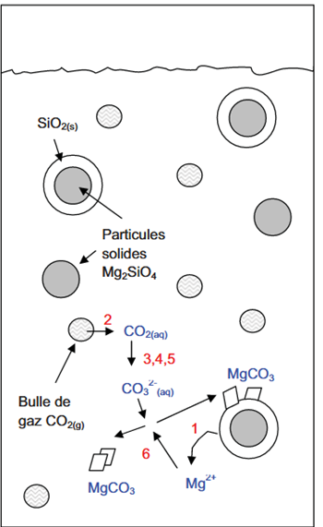
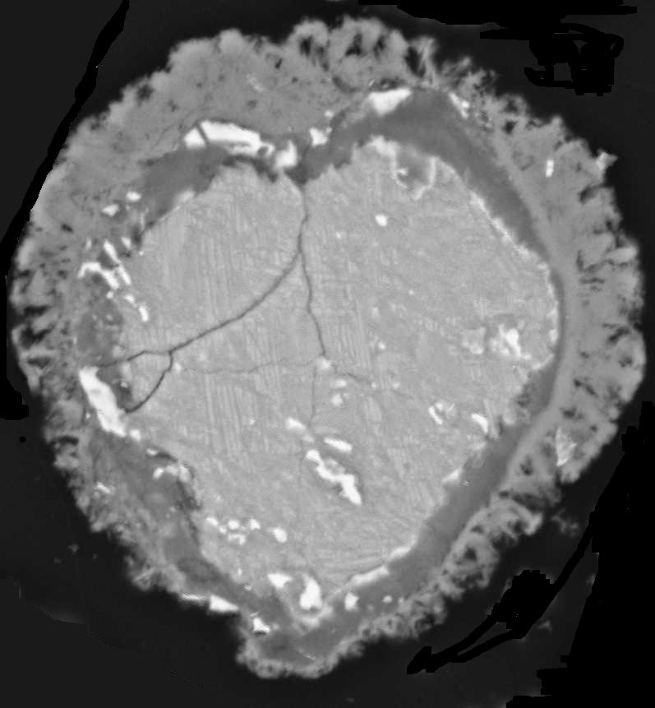
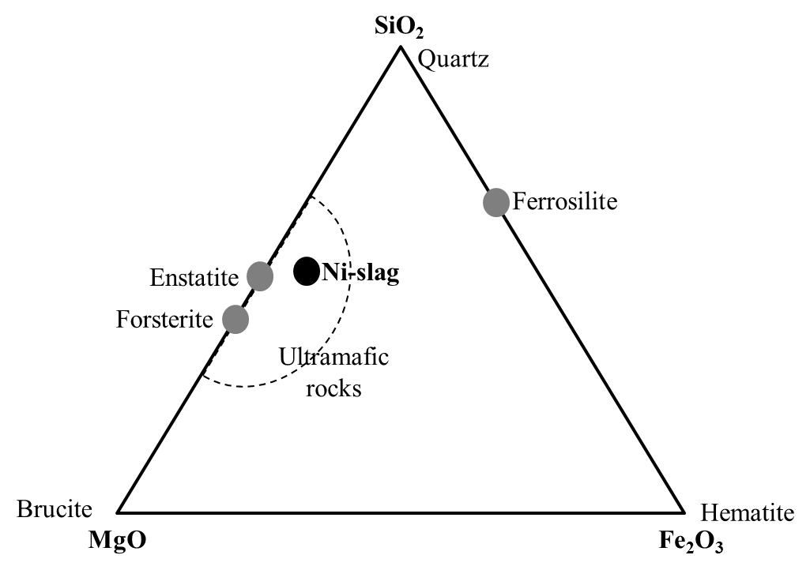
Process : Mineralization technology development
Passivation problem
intrinsic to all ores and waste leaching (dissolution) processes
Flue gas (CO₂)
Solid particles
(Ni-slag)
Gas bubble
(CO_{2(gas)})
14

Slide 15
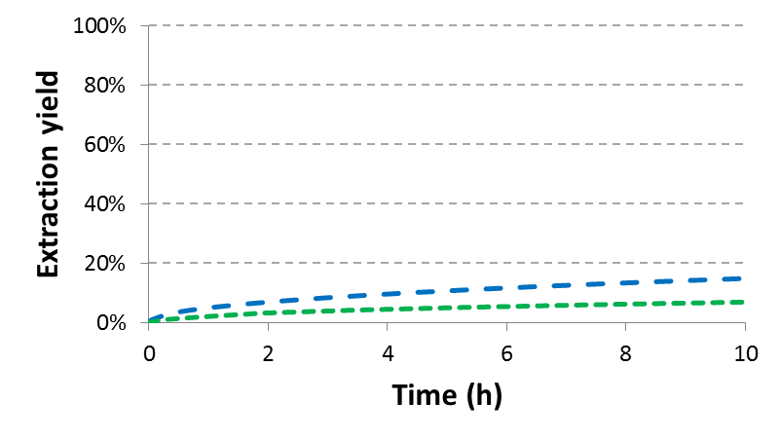
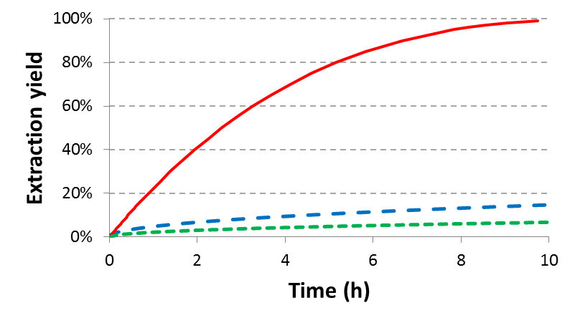
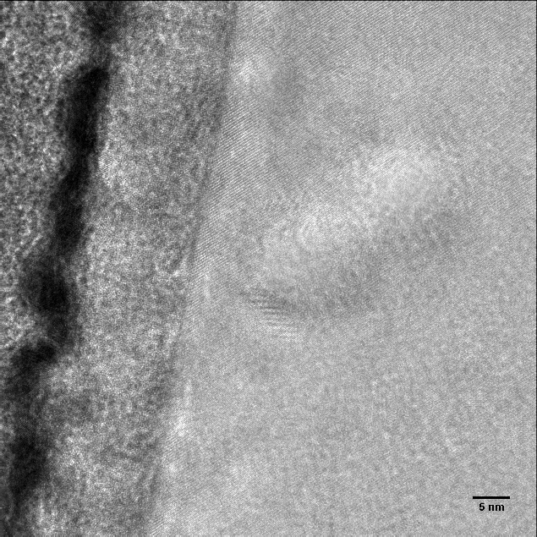
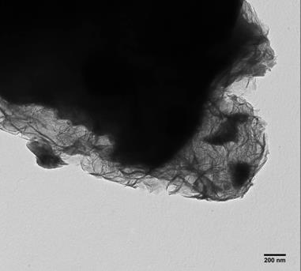
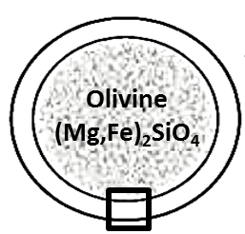
Process : Mineralization technology development
Surface controlled
reaction
Surface layer
Mg extraction yield
?
Diffusion controlled reaction
passivation
Time (hr)
Passivation
Diffusion controlled process
Feed material (olivine)
Initial olivine
Silica + iron oxide surface layer
Feed material (olivine)
Phyllosilicate (talc) surface layer
10-15 nm
3 g/L (< 100µm), 20 bar CO₂, 120°C
→ No carbonation
→ Less than 10% carbonation
(90 g/L (< 100µm), 20 bar CO₂, 180°C)
15

Slide 16
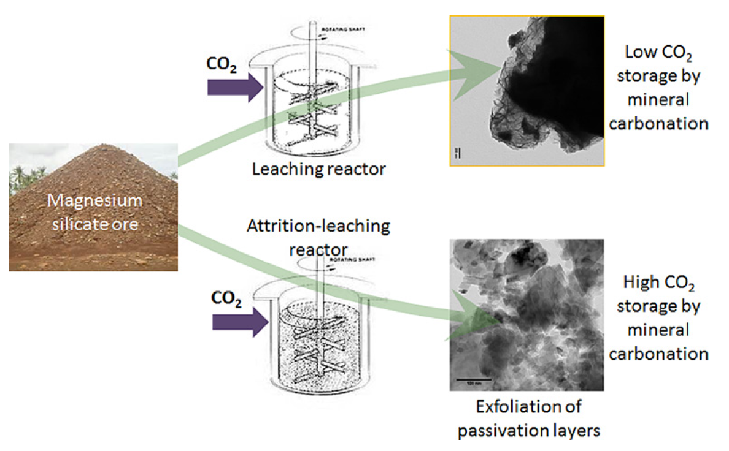
Process : Mineralization technology development
Development of an attrition-leaching hybrid process for direct aqueous mineral carbonation, Chemical Engineering Journal, 262, 2015.
Ex-situ mineral carbonation for CO₂ mitigation: Evaluation of mining waste resources, aqueous carbonation processability and life cycle assessment (Carmex project), Minerals Engineering, 59, 2014.
16

Slide 17
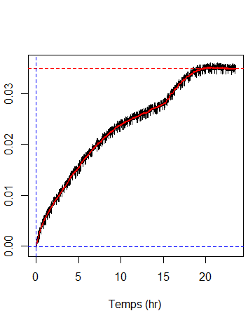
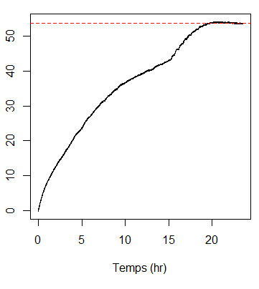
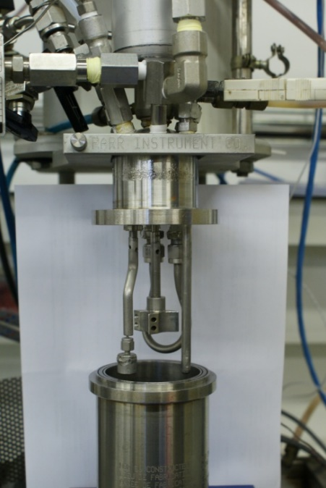
Process : Mineralization technology development
Example of slag mineralization experiment (170°C, 20 bar CO₂, Y-Zr grinding beads)
in a 300 mL batch reactor
Cumulative CO₂ consumption
Carbonatation yield (%)
Best performance in excess of 80% carbonation
Labscale stirred media mill
Self-built, 300 mL, batch,
120-180 °C, P_{CO2} < 20 bar
Time (hr)
Time (hr)
Composition of mineralized slags
Silica (am)
Carbonates (mainly MgCO₃)
Residual slag particles
17

Slide 18
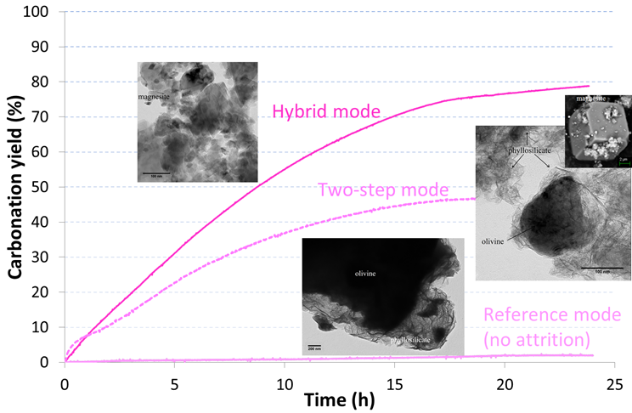
Process : Mineralization technology development
?
Synergy believed to be caused by surface amorphization (surface reactivity enhancement) during the leaching process, which increases the reaction rate and extent of reaction.
18

Slide 19
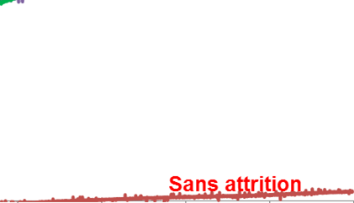
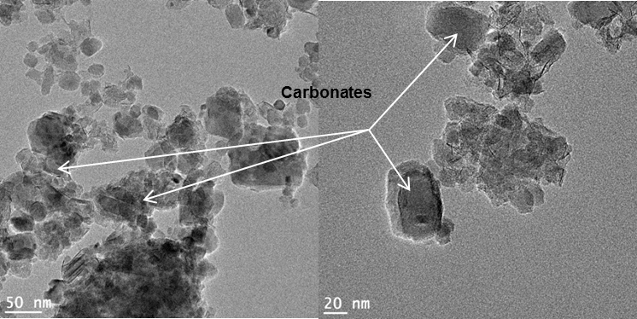
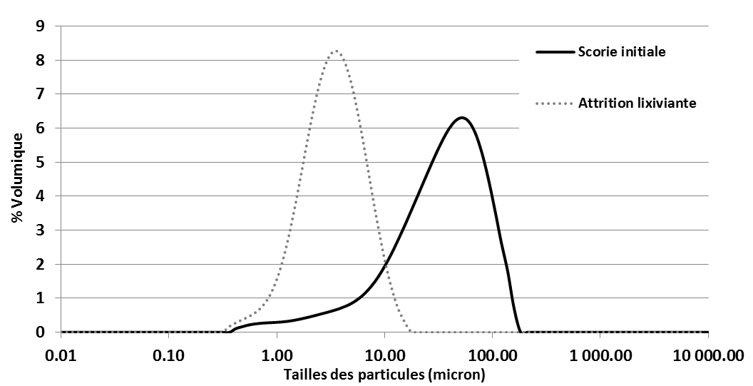
Process : Mineralization technology development
Attrition-leaching
SLN
KNS
180°C, 20 bar de CO₂
without
Micron size particles (see PSD below) that contain a mixture of MgCO₃, amorphous silica and unreacted slag phases
CO₂ consumption potential of Ni slags
∼ 0.4 t de CO₂ / t of Ni slag
Measured performance (without process optimisation)
0,3 t de CO₂ / t of SLN slag
0,2 t de CO₂ / t de KNS slag
Initial slag particle
After attrition-leaching process
0.01 0.1 1 10 100 1000 10000
Taille des particules (microns)
19

Slide 20
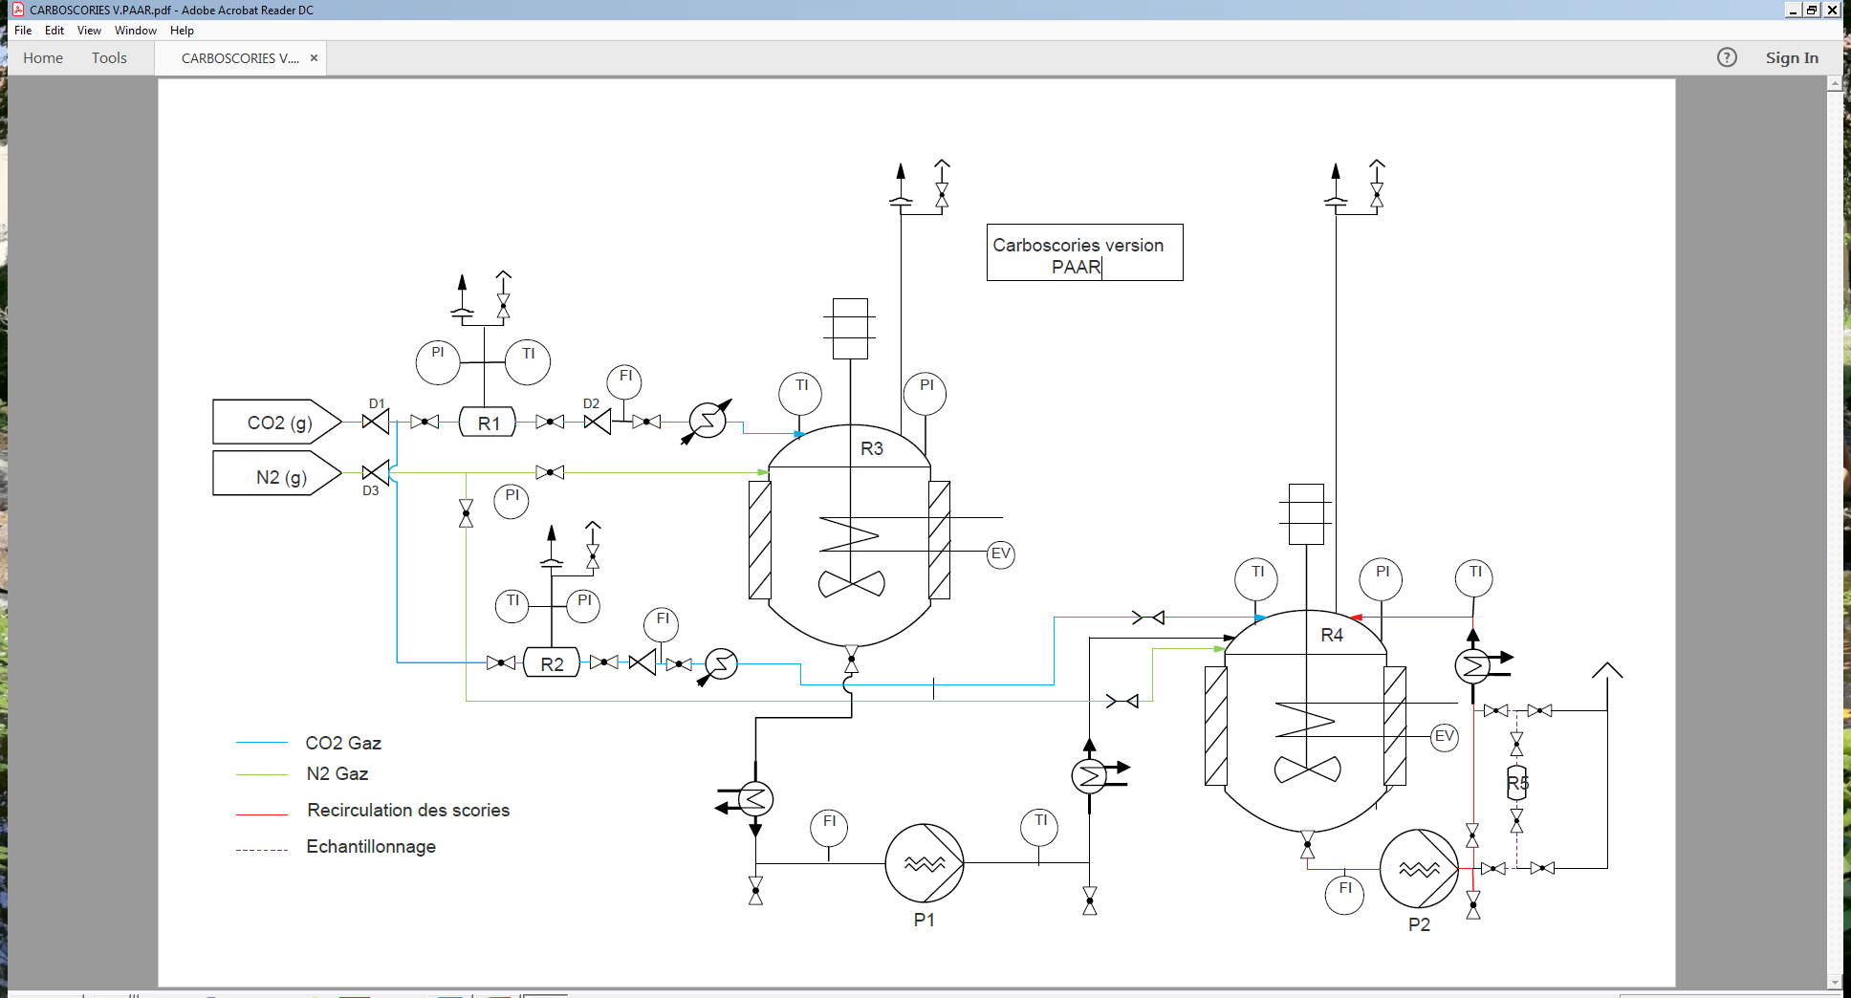
Process : Mineralization technology development
Pilot test rig development
  Objective 1: To produce sufficient quantities of products for product valorization testwork.
  Objective 2: To optimize the operating conditions (energy; water) and meet the product valorization specifications.
  Objective 3: To develop a solution that is scalable and acceptable by industry.
Gao et al., 2002
4L reactor; 100-300L/hr; P; T°
2009-2016: ANR/CARMEX
CNRT/CARBOSCORIES
2018-2021: ACE/CARBOSCORIES 2, ADEME/CARBOVAL
Post-2021: onsite demonstrator
20

Slide 21
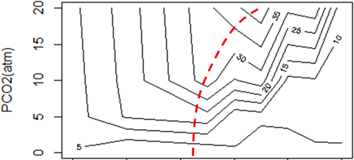
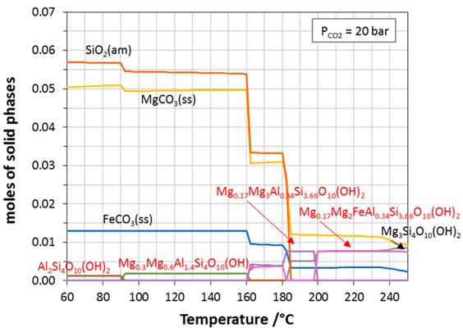


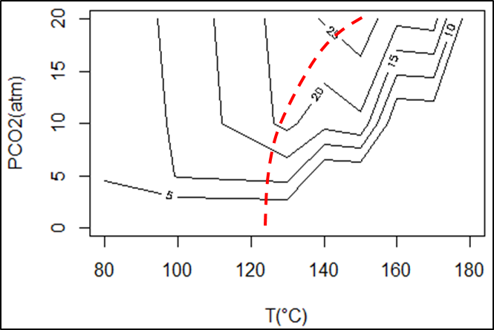
Process : Mineralization technology development
Some key points
Construction of a small pilot scale setup suitable for producing sufficient mineralized product for making and testing construction materials
Optimization of mineralization operating conditions (phase speciation and properties of mineralization products , process efficiency w.r.t. water, energy and throughput)
Product speciation
KNS slag-H₂O-CO₂ system
Mass fraction of carbonates
P_{CO2} (atm)
Technology
Process
Materials
Moles of solid phases
Moles de phases solides
Mass fraction of amorphous silica
P_{CO2} (atm)
Temperature (°C)
P_{CO2}, T
Temperature (°C)
Defining the operating conditions of the attrition-leaching process using thermodynamic process modeling, XXVIII International Mineral Processing Congress, 2016.
Guiding mineralization process development with geochemical modelling, 14th International Conference on Greenhouse Gas Control Technologies, 2018.
21

Slide 22
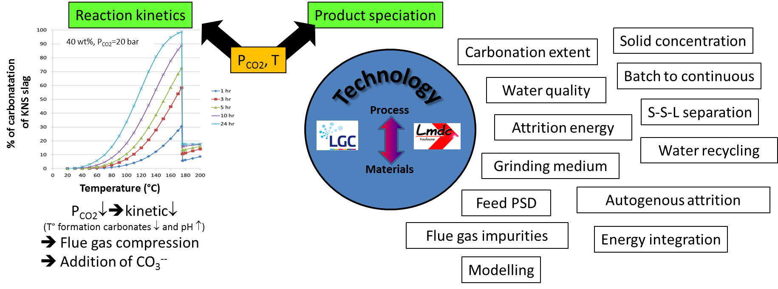
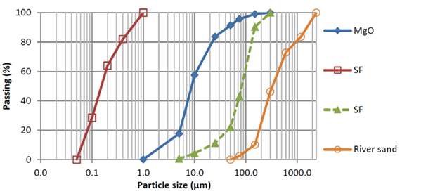
Process : Mineralization technology development
% carbonation
of KNS slag
Where is the right operating window of the attrition-leaching mineralization process?
PSD of raw mix constituents in Mg-based cements (MgO; Silica fume; sand)
- Interfacing between mineralization process performance and required product properties for valorization.
- Should the attrition rate match that of the surface rate of leaching ?
At any rate, the best operating point is utterly different from that of attrition processes ➔ attrition-leaching is a new process !
Yang et al., Properties of magnesium based cement, 2017
22
Notes:
Captage CO2 par membranes
+: Sélectivité
- : capacité
Il existe des petites installations clés en mains (http://www.lerouxlotz.com/produits_industry/unite-modulaire-de-captage-et-separation-du-co2/)
Captage CO2 par absorption (amines)
On peut fixer la pureté, ou la récupération, ou les 2.
Moins de récupération aboutira à de plus petites installations.

Slide 23
Product : Mg-based construction materials
Mineralization: A creative and engaging field
Mg-based mineralization products = future opportunities of CO₂ mineralization
As sand :
  Direct use of Ni-slags as a substitute to natural sand in concrete mix (recently, first shipment of 10,000 t from SLN "sland" product to Port Kembla (Australia). This is not a CO₂ mineralization pathway.
As Magnesium Silicate Hydrate (M-S-H) cement
Hydraulic binder :
  M-S-H is the glue
  Mg-Silicate ➔ M-S through a low-temperature calcination (~650°C);
  M-S + H₂O ➔ M-S-H + Mg(OH)₂ ;
  Mg(OH)₂ + reactive silica (additive) + H20 ➔ M-S-H
Magnesia-binders have been known since the mid-19th century, but no readily available source of MgO, as opposed
to CaCO₃ for production of CaO ➔ no reported commercial application of M-S-H.
Low-calcination temperature; high temperature resistance; long-term resistance improved as less reactive;
low pH (can be used for storage of heavy metal waste)➔ active ongoing research on properties of Mg-based cements.
  Which pathways ?
  Direct calcination of Mg-silicates: Uriah Cummings (1889 U.S. patent) uses a mixture of serpentine (73wt%) and fine silica (26wt%), which after calcination, forms a cement (hydraulic binder). This is not a CO₂ mineralization pathway (but avoided CO₂).
  Calcination of MgCO₃: as per calcination of CaCO₃. This is a CO₂ mineralization pathway (avoided CO₂).
23
Notes:
BF = Blast Furnace slags : 15-60% CaO;
Fly ash: 10-50% CaO
RCA: Waste (or Recycled) concrete aggregate =25-66% CaO
Red mud = 8% CaO; 30% Fe2O3; 25% Al2O3; 11% SiO2
Ca(OH)2 = portlandite
Steel slags = Stainless Steel slags; BOF slags; EAF slags;
CARBONCURE/Canada: Direct injection of CO₂ into concrete as it is being mixed (less cement usage per ton of concrete: ↘cost; ↘ CO₂ emissions) = Accelerated carbonation of concrete
CEU = State Key Laboratory on Clean Energy Utilization
wollastonite CS = CaSiO₃, rankinite C₃S = Ca₃Si₂O₇, belite C₂S = Ca₂SiO₄
Water to solid ratio of 0.1 is conducive to (favours) carbonation reactions

Slide 24
Product : Mg-based construction materials
Mineralization: A creative and engaging field
Mg-based mineralization products = future opportunities of CO₂ mineralization
As Magnesium Silicate Carbonate (M-S-C) cement
Process analogous to the Solidia Technology solution for Ca-silicates; carbonate cements cure with CO₂ instead of water.
Production of calcined phases, which mineralize in-situ in the presence of CO₂ and water. This is a CO₂ mineralization pathway (CO₂ eliminated).
Conceivable to mix M-S-C with other phases.
As pozzolanic materials for hydraulic binders
CaO + (MgCO₃+SiO₂(am)) + eau ➔ C-S-H ; the desirable product is the reactive amorphous silica, which can be produced by mineralization of Mg-silicates. MgCO₃ is an inert filler that removes CO₂. This is a CO₂ mineralization pathway (CO₂ eliminated).
As specialty mineral products (low tonnage)
MgCO₃ .This is a CO₂ mineralization pathway (CO₂ eliminated).
Si(am)
All creative solutions that use different feedstocks available locally, partially or completely mineralized to produce low CO₂ emission materials for the construction sector ought to be considered.
➔ Creativity in materials formulation (properties, acceptability) AND transparent evaluation of global environmental and economic value.
➔ The "resource-process-product" mineralization tryptich.
24

Slide 25
Product : Mg-based construction materials
Some key points
Interfacing the mineralization process with the fabrication of magnesium fillers and binders (phase speciation, water management: recycling, product moisture, modeling)
Demonstrate that the manufacture of magnesium binders is possible from mineralization products: choice of binders will depend on the chosen application.
Fabricate these binders and study their reactivity and durability (durability, impact of impurities on the integrity of the cement)
Acceptability of the valorization products for the intended use
For which applications ?
Structural construction: depending on applicable standards
Non-structural construction: blocks, pavers, curbs, pool edges, stabilized bricks, etc.
Road infrastructure: treated road sub-layers, soil stabilization, capping layers, etc.
Coastal protection (erosion, submersion)
Artificial reefs
25

Slide 26



Environmental and Economic Analysis
Product-oriented LCA
FU: 1 kg of product
Example of LCA criterion : CO₂
TODAY
Ore
Ni mining and metallurgy
Power station
$$CO2energy$$
$CO2$_{production Ni}
Nickel
Ni Slag
$$CO2Ni slag$$
Slag storage
26
Notes:
Vert: ce qui est rajouté au système.
Un produit valorisé a une fonction et remplace une fonction équivalente.
Produits: utilisés ou non en Nouvelle-Calédonie.
Remplacement de fonction identique en 1 pour 1.

Slide 27


Environmental and Economic Analysis
Product-oriented LCA
FU: 1 kg of product
Example of LCA criterion : CO₂
TOMORROW
Ore
Production
Ni mining and metallurgy
Power station
$$CO2energy$$
$CO2$_{production Ni}
Current construction material
$$CO2substituted material$$
Nickel
Scories
Ni Slag
$$CO2Ni slag$$
Slag storage
Mineralization &
Transformation
$$CO2mineralization$$
avoidance
FU: valorized product (1kg)
avoidance
Which products are environmentally and economically interesting to replace with mineralized slags?
27
Notes:
Un produit valorisé a une fonction et remplace une fonction équivalente.
Produits: utilisés ou non en Nouvelle-Calédonie.
Remplacement de fonction identique en 1 pour 1.
Vert: ce qui est rajouté au système.

Slide 28
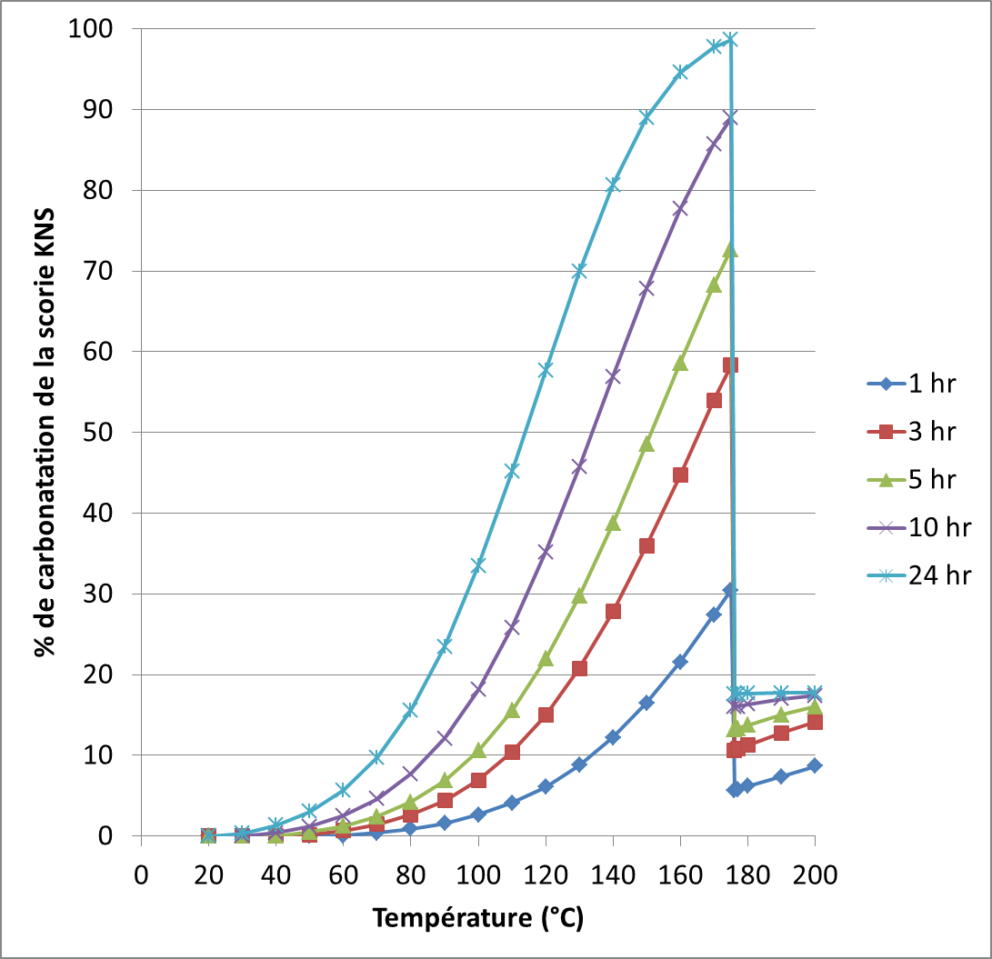
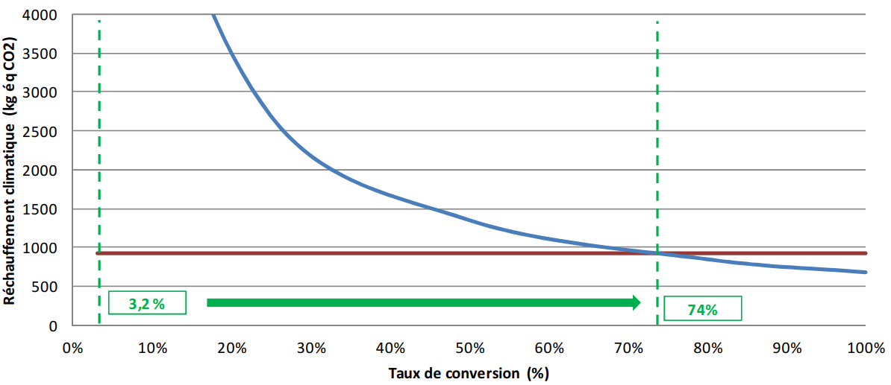
Environmental and Economic Analysis
Action/product oriented LCA can be used to guide mineralization process development
Illustration using an early analysis of the mineralization without product valorization, whereby the functional unit = "To produce 1 MWhe with a coal-fired power station""
Climate change criterion
74%
System 1 – Coal power station without CO₂ capture
Système 2 – Coal power station with mineralization
Global warming (kg eqCO2)
Achievable in 5 hr at 180°C, in 10 hr at 150°C, etc. (LCA calculations were made at 180°C, 24hr)
Extent of conversion (%)
Source: BioIntelligenceService. ANR CARMEX project, final report v2.0., dec. 2012
28

Slide 29






Environmental and Economic Analysis
Material Flux Analysis (MFA) at the regional scale
Example of LCA criterion : CO₂
Ore
Production
Power station
$$CO2capture$$
Ni mining and metallurgy
Current construction material
$$CO2subsituted material$$
Nickel
Ni slag
Stock2
$$CO2stock2$$
Slag storage
Mineralization &
Transformation
$$CO2mineralization$$
$$CO2Ni slag$$
Total waste flux
Total products valorized locally (kg)
What territorial needs do mineralization products meet?
Search for maximum environmental and economic performance: matching needs & requests to avoid stocks
Stock1
$CO2stock$₁
Total construction materials market
29
Notes:
Il n'y a plus d'UF a proprement parler, ici on est à l'échelle du territoire, et on regarde tout ce qu'on va pouvoir faire avec les scories de Ni valorisées.
Chaque rond représente un marché.
Les flèches représentent ici juste ce qui change en termes du critère ACV étudié, ici le CO2.
On chercher à éviter les stocks, qui sont des stocks d'invendus.
Analyse économique non indiquée: on cherchera à remplacer les produits importés pour que cela ait un sens économique.
L'idée est de ne pas perturber l'économie ➔ ramener 1-beta et 1-gamma vers 0.

Slide 30
Environmental and Economic Analysis
Some key points
Data collection at all scales, from the process to the territory and abroad (potential export markets).
Guiding the development of the mineralization process by an "action-oriented" LCA (attributional LCA) to identify the levers of action for minimization of environmental impacts at the product level. This requires a process-product metamodel and a sensitivity analysis.
Ensuring that the overall triptych "resource-process-products" brings a net environmental and economic benefit by a "territorialized LCA of waste management" (territorial consequential LCA). This LCA corresponds to the development of a territorial model of slag management and valuation in the regional context of New Caledonia. This task should test various economic scenarios for replacing resources with valuable products in the local geographical and economic context, looking for scenarios that make local economic sense, and calculating the corresponding environmental impacts.
30

Slide 31









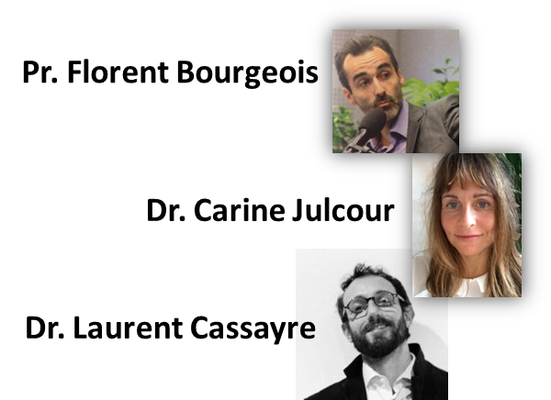
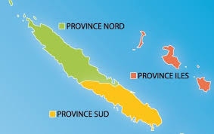







Thank you for your kind attention
ACE/CARBOSCORIES 2 – ADEME/CARBOVAL
2018 - 2021
Research team and main responsibilities
- New-Caledonian context and Nickel mining industry
CNRT / www.cnrt.nc – france.bailly@cnrt.nc
- Mineralization process development and overall project coordination
LGC / https://lgc.cnrs.fr/en/ – florent.bourgeois@ensiacet.fr , carine.julcour@ensiacet.fr , laurent.cassayre@ensiacet.fr
- Product development for the construction sector
LMDC / http://www-lmdc.insa-toulouse.fr/ – martin.cyr@insa-toulouse.fr
- Economic and environmental evaluation
BRGM / https://www.brgm.fr/ – s.touze@brgm.fr
IFSTTAR / https://www.ifsttar.fr/ – anne.ventura@ifsttar.fr , michel.dauvergne@ifsttar.fr , lauredan.leguen@ifsttar.fr
ESO / http://eso-nantes.cnrs.fr/ – jeanbaptiste.bahers@univ-nantes.fr
LEMNA / https://lemna.univ-nantes.fr/ – nicolas.antheaume@univ-nantes.fr
@LGClab
31
Dr. Anne Ventura
Dr.
New-Caledonia
Dr. Jean-Baptiste Bahers
Pr. Nicolas Antheaume

